Slide 1
Character Analysis
Wonder

Slide 2
Book Summary

Slide 4
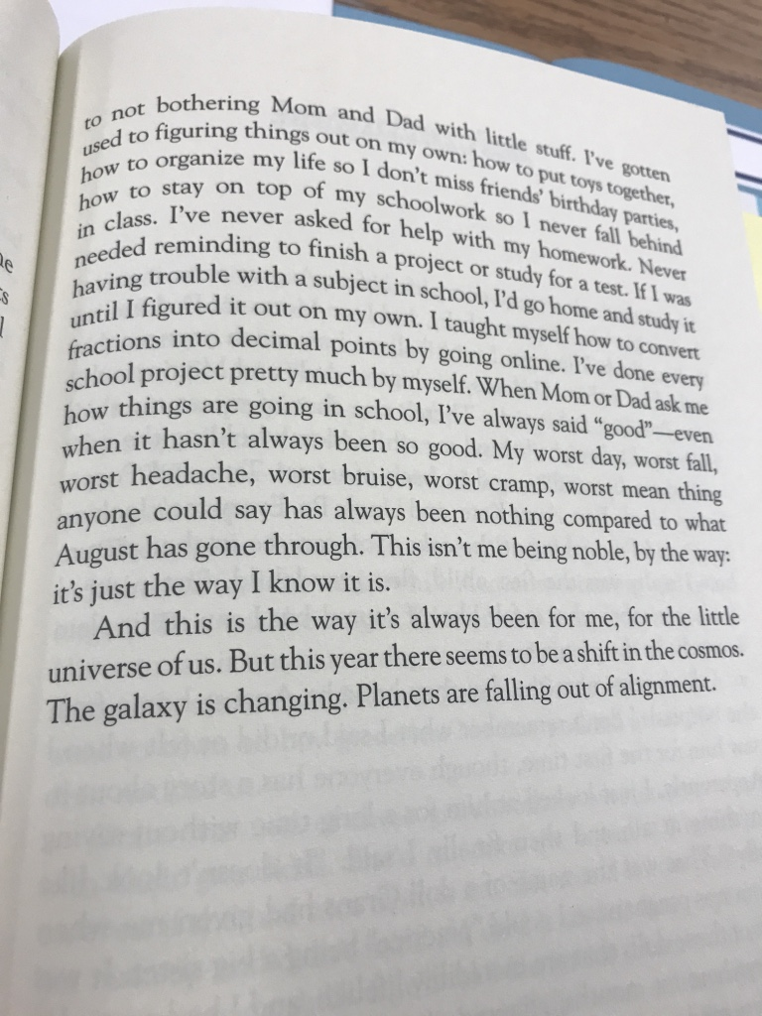
Via

Slide 5
SUMMER

Slide 6
Summer

Slide 7
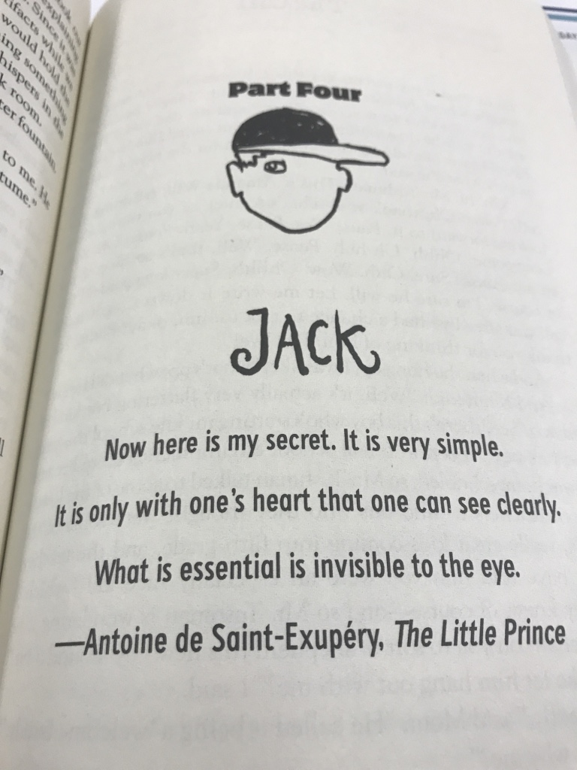

Slide 8
JACK

