Slide 1
The lightning thief
Gods and Godesses

Slide 2
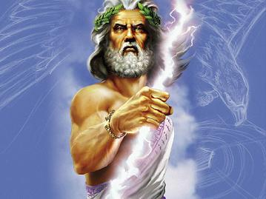
zeus
God of the Sky (Zoos) Distinguishing Features: Pinstriped suit, neatly trimmed grey beard, stormy eyes and a very large, dangerous lightning bolt. Now: On stormy days, he can be found brooding in his throne room in Mount Olympus, over the Empire State Building in New York. Sometimes he travels the world in disguise, so be nice to everyone! You never know when the next person you meet might be packing the master bolt. Then: In the old days, Zeus ruled over his unruly family of Olympians while they bickered and fought and got jealous of each other. Not much different than today, really. Zeus always had an eye for beautiful women, which often got him in trouble with his wife, Hera. A less-than-stellar father figure, Zeus once tossed Hera’s son Hephaestus off the top of Mount Olympus because the baby was too ugly. Symbol: Eagle Roman name: Jupiter

Slide 3
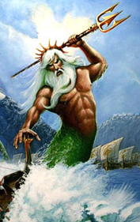
poseidon
God of the Sea (Po-sigh’-dun) Distinguishing Features: Hawaiian shirt, shorts, flip flops, and a three-pointed trident. Now: Poseidon walks the beaches of Florida, occasionally stopping to chat with fishermen or take pictures for tourists. If he’s in a bad mood, he stirs up a hurricane. Then: Poseidon was always a moody guy. On his good days, he did cool stuff like create horses out of sea foam. On his bad days, he caused minor problems like destroying cities with earthquakes or sinking entire fleets of ships. But hey, a god has the right to throw a temper tantrum, doesn’t he? Symbol: Three-pointed trident Roman name: Neptune

Slide 4
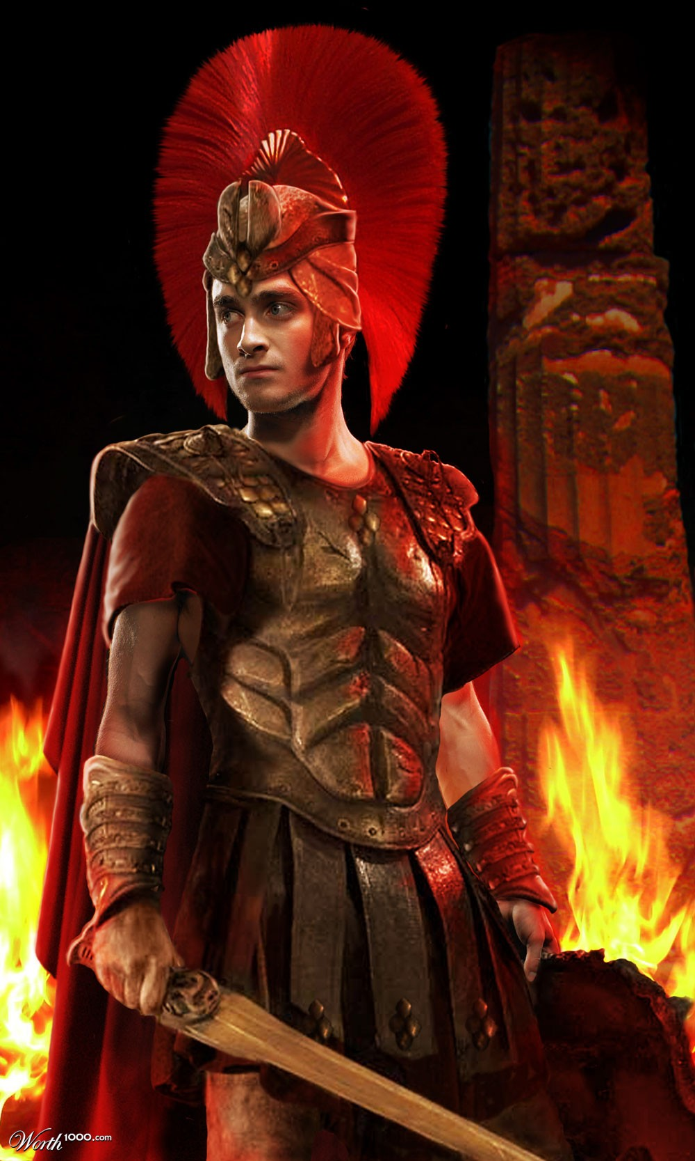
ares
God of War (Air’-eez) Distinguishing Features: Biker leathers, Harley Davidson, sunglasses and a stinking attitude. Now: Can be found riding his Harley around the suburbs of LA. One of those gods who could pick a fight in an empty room. Then: Back in the day, this son of Zeus and Hera used to be inseparable from his shield and helmet. Fought on the side of the Trojans during the war of Troy, but, frankly, has been involved in every minor skirmish since Goldilocks told the three bears that their beds were a little uncomfy. Symbol: A bloody spear, a wild boar (the animal with the nastiest attitude) Roman name: Mars

Slide 5
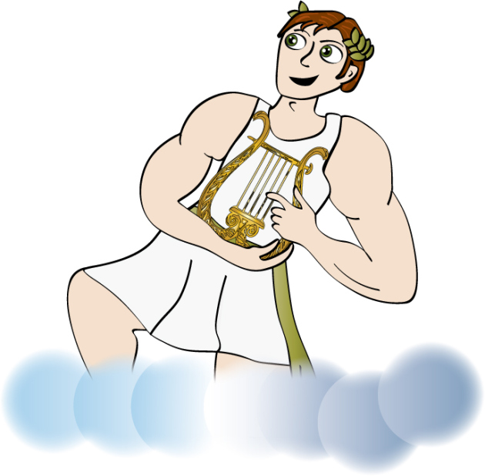
apollo
God of archery, music, poetry, prophecy, medicine, and later on the god of the sun. (Ah-paul’-oh) Distinguishing Features: You’ve got to dig the shades. Apollo likes to look hot, and I don’t mean temperature. He typically looks like a movie star with the fashionably shabby clothes, the laid back attitude, the brilliant smile, and the Ray Ban sunglasses. His sun chariot morphs into a fine Maserati. Now: Do NOT ask him to recite his poetry. Seriously. You can find Apollo cruising down Sunset Avenue looking cool, or hanging out at parties chatting with writers or rock stars. He likes to be the center of attention wherever he goes. He’s a nice enough guy, as long as you agree that he’s the coolest person on earth. Just don’t get him angry, or he can get a little hot under the collar. Then: Apollo was into everything, from music to medicine, probably because he thought he was better at everything than anyone else. When the old sun god Helios retired, Apollo took over that job too, though he was mostly thought of as the god of poetry and music. Apollo didn’t take criticism well. One time he asked King Midas to judge a contest between him and Pan, and when Midas decided Pan’s music was better, Apollo gave the king donkey ears. The lesson: if someone asks your opinion, think carefully before you answer. Symbol: the lyre, laurel wreath Roman name: Apollo (you can't improve on perfection, baby!)

Slide 6
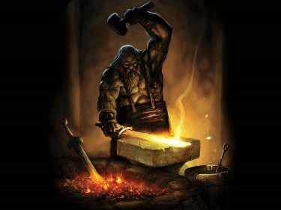
haphaestus
God of blacksmiths and fire (Huh-fess’-tus) Distinguishing Features: Ugly face, scraggly beard, massive powerful hands. Usually wears a mechanic’s uniform with his name embroidered on the pocket so he doesn’t forget who he is. Now: The god likes to hang out in his workshop fixing cars and building inventions. He’s not very good with people, but he can do anything with machines. You want a robot to do your homework, or a life-sized metal giant to stomp on your enemies. Hephaestus can have one ready in a matter of hours. Then: Poor Hephaestus was ugly from birth, but he didn’t get any prettier when his parents chucked him down the side of Mount Olympus, making him a cripple forever after. He’s not much to look at, but he’s clever with his hands. The Olympians made Aphrodite marry him, thinking that it would settle her down, but that didn’t work out too well. Hephaestus is a jealous husband, always on the lookout for that scoundrel Ares and anyone else who might want to flirt with his wife (which is basically every man with a pulse). Symbol: The anvil and hammer Roman name: Vulcan (no Star Trek jokes, please)

Slide 7
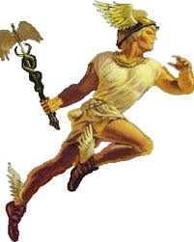
hermes
God of the Roadways, Travelers, Merchants and Thieves (Her’-meez) Distinguishing Features: Jogger’s clothes and winged athletic shoes, a cell phone that turns into the caduceus, his symbol of power – a winged staff with two snakes, George and Martha, entwined around it. Now: Hermes is a hard person to find, because he’s always on the run. When he’s not delivering messages for the gods, he’s running a telecommunications company, an express delivery service, and every other type of business you can imagine that involves travel. Did you have a question about his activities as god of thieves? Leave a message. He’ll get back to you in a few millennia. Then: Hermes got started young as a troublemaker. When he was one day old, he sneaked out of his crib and stole some cattle from his brother Apollo. Apollo probably would’ve blasted the young tyke to bits, but fortunately Hermes appeased him with a new musical instrument he created called the lyre. Apollo liked it so much he forgot all about the cows. The lyre made Apollo very popular with the ladies, which was more than he could say about the cattle. Symbol: the caduceus Roman name: Mercury

Slide 8
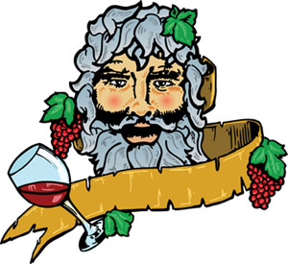
dionysus
God of Wine (Dī-oh-nī’-sus) Distinguishing Features: Leopard-skin shirt, walking shorts, purple socks and sandals, the general pasty demeanor of someone who has been up partying much too late. Now: Dionysus has been sentenced to one hundred years of “rehab” as director of Camp Half-Blood. The only thing the god of wine can drink these days is Diet Coke, which doesn’t make him happy. He can usually be found playing pinochle with a group of terrified satyrs on the front porch of the Big House. If you want to join the game, be prepared to bet large. Then: Dionysus invented wine, which so impressed his father Zeus that he promoted Dionysus to god. The guy who invented prune juice, by contrast, got sentenced to the Fields of Punishment. Dionysus mostly spent his time partying it up in Ancient Greece, but once a crew of sailors tried to kill him, thinking the god was too incapacitated to fight back. Dionysus turned them into dolphins and sent them over the side. The moral of this story: Do not mess with a god, even a drunk one. Symbol: the leopard, the grape vine Roman name: Bacchus

Slide 9
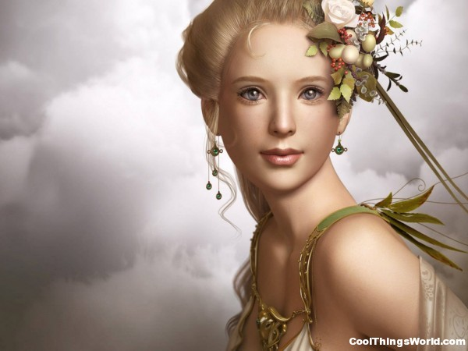
aphrodite
Goddess of Love and Beauty (Ă-fro-dī’-tee) Distinguishing Features: She’s really, really pretty. It’s hard to be more specific, because Aphrodite can change her appearance to become whatever you find most beautiful. Now: She’s more beautiful than Angelina Jolie. She can often be found shopping on Fifth Avenue or trying on new clothes during Fashion Week in New York. She loves parties, and can’t get enough of gossip. If that sounds like a lot of people you know, you’re probably right. Any of them might be Aphrodite in disguise. Then: She’s more beautiful than Helen of Troy. Aphrodite wasn’t afraid to use her beauty to get what she wanted, either. She promised Prince Paris the most beautiful mortal woman in the world if he judged Aphrodite the fairest goddess in a contest, and Paris readily agreed. When he got Helen for his wife, it started the Trojan War and thousands died, but hey, at least Aphrodite got what she wanted! Symbol: the dove, which is odd, since it’s a symbol of peace and Aphrodite started a war, but oh well. Looks are everything. Roman name: Venus

Slide 10
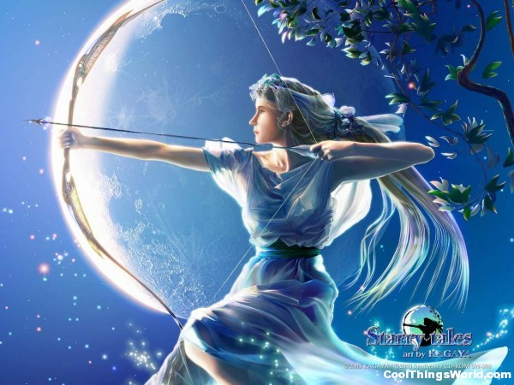
artemis
Goddess of the moon, the hunt, and young maidens (Ar’-tem-iss) Distinguishing features: Artemis likes to appear as a regular mortal maiden of about twelve or thirteen, but don’t let that fool you. Artemis is deadly with her bow, and doesn’t suffer fools, especially male fools. Her eyes are silver like the moon, and she tends to dress in white and silver. Now: Artemis can be found roaming the countryside with her handmaidens, the Hunters of Artemis. Imagine an immortal, very deadly Girl Scout troop, on a permanent camp out, hunting monsters. Don’t get in their way, and don’t try to flirt with them. These Girl Scouts do NOT sell cookies. Then: Artemis enjoyed hunting with her handmaidens and basically kept to herself unless she was bothered. Once a male hunter tried to spy on Artemis while she was bathing. The goddess turned him into a deer and her hunters tracked him down and killed him. Basically, she doesn’t have much of a sense of humor when it comes to peeping toms. Symbol: The moon, the deer Roman name: Diana

Slide 11
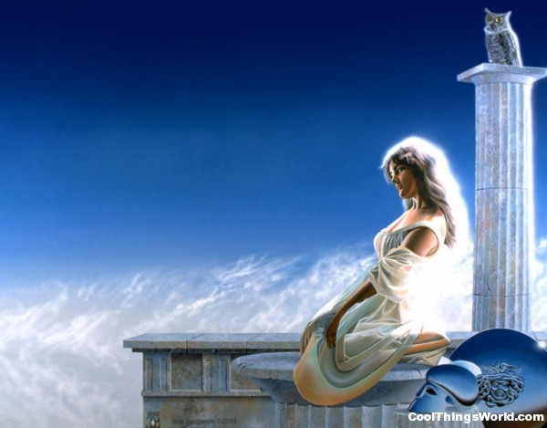
athena
Goddess of Wisdom, War, and Useful Arts (Ah-thee’-nah) Distinguishing Features: Dark hair, striking grey eyes, casual yet fashionable clothes (except when she’s going into battle; then it’s full body armor). Athena is always accompanied by at least one owl, her sacred (and fortunately housebroken) animal. Now: You’re likely to spot Athena at an American university, sitting in on lectures about military history or technology. She favors people who invent useful things, and will sometimes appear to reward them with magical gifts or bits of useful advice (like next week’s lottery numbers). So start working on that revolutionary new bread slicer! Then: Athena was one of the most active goddesses in human affairs. She helped out Odysseus, sponsored the entire city of Athens and made sure the Greeks won the Trojan War. On the downside, she’s proud and has a big temper. Just ask Arachne, who got turned into a spider for daring to compare her weaving skills to Athena’s. So whatever you do, DO NOT claim that you fix toilets better than Athena. There’s no telling what she’ll turn you into. Symbol: The owl Roman name: Minerva

Slide 12
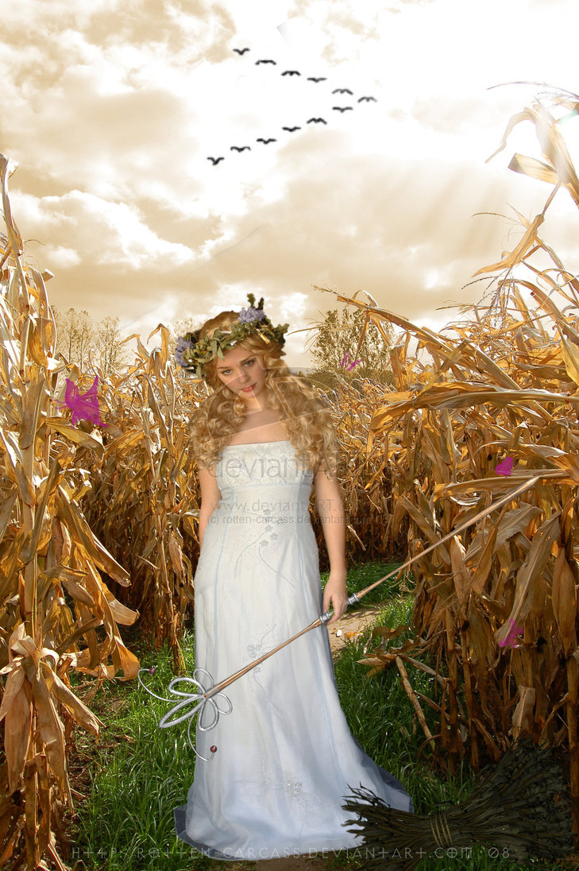
demeter
Goddess of Agriculture (Duh-mee’-ter) Distinguishing Features: The goddess prefers simple dresses of green or gold, though you can often find her in gardening clothes. Now: Demeter divides her time between the upper world, where she oversees the growing season and produces commercials encouraging people to eat more cereal products (part of a balanced breakfast!), and the Underworld, where she visits her daughter Persephone and plays the wicked mother-in-law to Hades, who kidnapped her poor little daughter eons ago. He’s still not good enough for Persephone. She should’ve married the god of doctors! Then: Demeter was one of the quieter goddess. As long as the crops were growing and the farmers were happy, Demeter was content. But don’t underestimate her importance. If you wanted to eat, you had to make sure you kept on Demeter’s good side. When Hades stole her daughter Persephone, Demeter stopped all plants from growing, and people started starving. Hard to make a cheeseburger with no grain for bread and no grass for the cows. Symbol: Torch, Corn plant (though popcorn works, too) Roman name: Ceres

Slide 13
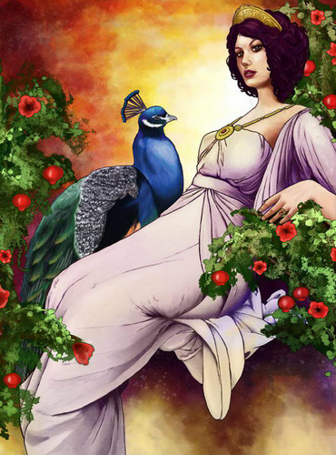
hera
Goddess of Marriage, Mothers and Families (Hair’-ah) Distinguishing Features: Usually prefers classic Greek dresses and a simple silver crown, though she can blend in as needed. She usually appears as a beautiful older woman, and enjoys turning into birds when she needs to hide or spy. Now: She hangs out where family life is strongest: the car pool line at school, weekend soccer games, and birthday parties. That strange woman you saw at Laser Quest, serving pizza and singing Happy Birthday? Yes, that was probably her. As the goddess of family, Hera will be happy to pack your lunch or comb your hair or give you a ride to school, but don’t talk back to her. When Hera is mad, she doesn’t just ground you. She’s likely to smash you into the ground. Then: It’s tough to be the goddess of marriage in a family where everyone cheats on everybody. Hera has no patience with demigods, the children of godly affairs. She was the enemy of Heracles and many others, though she did have a soft spot for mortal heroes, like Jason. If an old woman asks you to carry her piggyback across a river, do it. You might win the favor of a goddess! Symbol: pomegranate, cow (the motherly animal – no comments, please!), peacock Roman name: Juno

Slide 14
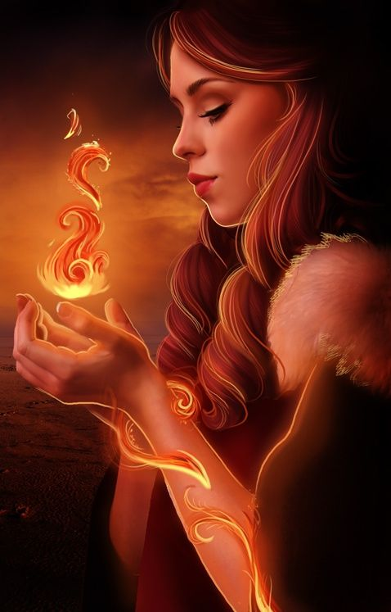
Hestia
Hestia was the goddess of hearth, home, and family. She was the eldest daughter of the Titans Kronos and Rhea. Both Poseidon and Apollo wanted to marry her, but she swore to Zeus that she would never marry. Hestia kept the fire burning in every hearth, providing warmth and security. Her symbol is a living flame and her sacred animals are a donkey and pigs.

Slide 15
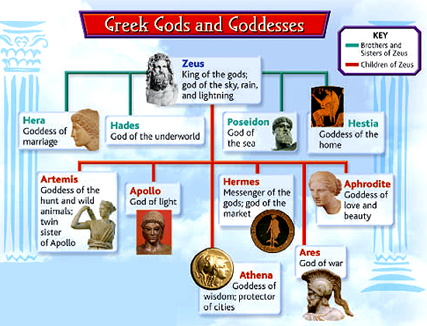
Greek gods and goddesses
Brain Pop
http://www.brainpop.com/socialstudies/worldhistory/greekgods/preview.weml

Slide 16
Chapter1 affixes
Complete a discipline from either Percy for pushing Nancy in the fountain or Nancy picking on Grover.

Slide 17
Chapter 2 Cause and effect
Complete a graphic organizer or T-chart with pros and cons of boarding school vs. public school.

Slide 18
Chapter 3 Fact/Opinion
Create a character collage. (Percy, Grover, Nancy Bobofit, Mrs. Dodds, Mr. Brunner, Smelly Gabe, and Sally Jackson) Write a quote they said under each picture.

Slide 19
Chapter 4
Create a sequencing activity by describing main events and listing them in correct order
**optional** Write a letter to Gabe (as Percy) explaining how his car got towed.

Slide 20
Chapter 5
Summarize the chapter.
Beginning, middle, end

Slide 21
Chapter 6
**Choices**
Draw the camp-detailed in KIDSPIRATION
Complete the 12 Olympian Gods Graphic Organizer
Respond to: If you could visit a God which one would it be and why?

Slide 22
Chapter 7 Inferring
Plat Tournament Day

Slide 23
Chapter 8
Cause and effect

Slide 24
Chapter 9
Ask the Oracle a Question about the future
**optional** watch this video http://abc.net.au/arts/winegsandals/oracle

Slide 25
Chapter 10 Multiple meanings
Complete a graphic organizer
**optional** describe what Fury would look like

Slide 26
Chapter 11 Cloze activity
Complete “Multiple meanings too”
Write an obituary for Medusa. Include facts about her life and death, where people can send flowers, and view body?

Slide 27
Chapter 12
Create your own Tournament Day questions (like chapter 7)
Even though cell phones are dangerous, type out a text message to Chiron. It must be 150 characters or less.

Slide 28
Chapter 13
Complete the Word search

Slide 29
Chapter 15 Quotations
Create Lightning Thief trading cards

Slide 30
Chapter 16 squencing
Take a virtual field trip to Las Vegas
http://www.lasvegaskids.net

Slide 31
Chapter 17
Create an AD for Crusty’s Waterbed Palace

Slide 32
Chapter 18
Visit this website
http://abc.net.au/arts/wingedsandals/ga,es/Cerberus.htm

Slide 33
Chapter 19 which words best describe
Draw a map of the underworld and compare and contrast to that of Grover’s.

Slide 34
Chapter 20
Summarize the chapter using “Breakouts”

Slide 35
Chapter 21

Slide 36
Chapter 22
**Choices**
Play Vocab bingo
Create a new front cover to the book
Create a wanted poster for Luke
Create your own Demi God

